Slide 1
Advanced Graphics

Slide 2
New Graphics Library
We are moving away from gpdraw so we can use extended capabilities in the java.awt.* library.

Slide 3
java.awt.*
Contains all of the classes from creating user interfaces and for painting graphics and images

Slide 4
Drawing Individual Pixels

Slide 5
Dotted Line
import java.awt.*;
public class GraphicsEx1 extends java.applet.Applet
{
public void paint(Graphics g)
{
for (int x=100, y=100; x <= 500; x+=5, y+=5)
g.drawLine(x,y,x,y);
}
}

Slide 6
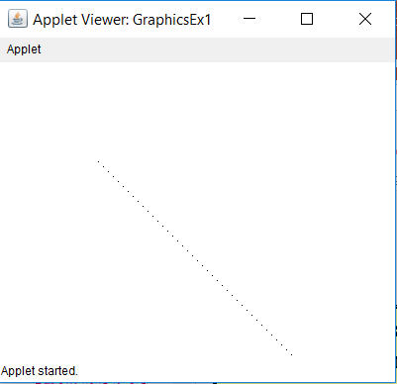
GraphicsEx1 Output

Slide 7
Dotted Line
import java.awt.*;
public class GraphicsEx2 extends java.applet.Applet
{
public void paint(Graphics g)
{
for (int x=100, y=100; x <= 500; x+=5, y+=5)
g.fillRect(x,y,2,2);
}
}

Slide 8
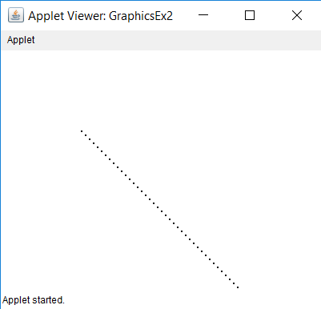
GraphicsEx2 Output

Slide 9
Using the Font Class

Slide 10
// Type is either "Courier","TimesRoman", "Arial", or any other available font.
// Style is either BOLD, ITALIC or PLAIN. Size is the point value of the font.
import java.awt.*;
public class GraphicsEx3 extends java.applet.Applet{
public void paint(Graphics g){
g.drawString("Default Appearance with drawString",20,20);
g.setFont(new Font("Courier",Font.PLAIN,20));
g.drawString("Courier 20-point plain font",20,60);
g.setFont(new Font("Courier",Font.BOLD,20));
g.drawString("Courier 20-point bold font",20,100);
g.setFont(new Font("TimesRoman",Font.PLAIN,36));
g.drawString("Times Roman 36-point plain font",20,180);
g.setFont(new Font("TimesRoman",Font.ITALIC,36));
g.drawString("Times Roman 36-point italic font",20,260);
g.setFont(new Font("Arial",Font.PLAIN,48));
g.drawString("Arial 48-point plain font",20,360);
g.setFont(new Font("Arial", Font.BOLD + Font.ITALIC, 48));
g.drawString("Arial 48-point bold and italic font",20,460);
g.setFont(new Font("Qwerty",Font.PLAIN,24));
g.drawString("Arial 24-point plain font substituted for non-existent Qwerty font",20,520);
}
}

Slide 11
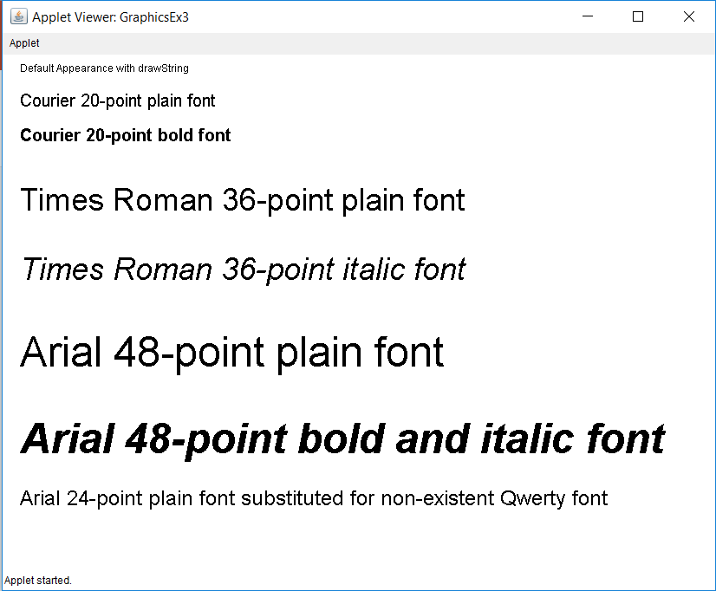
GraphicsEx3 Output

Slide 12
setFont Method
g.setFont(new Font("Courier",Font.BOLD,20));
alters the default font to Courier, Bold and size 20.
An object of the Font class is used to change the font.

Slide 13
Mathematics and Polygons

Slide 14
import java.awt.*;
public class GraphicsEx4 extends java.applet.Applet{
public void paint(Graphics g){
int x,y;
int radius = 100;
int centerX = 200;
int centerY = 200;
g.setColor(Color.blue);
for (double radian = 0; radian <= 2 * Math.PI; radian += 0.01){
x = (int) Math.round(Math.cos(radian) * radius) + centerX;
y = (int) Math.round(Math.sin(radian) * radius) + centerY;
g.drawLine(x,y,x,y);
}
}
}

Slide 15
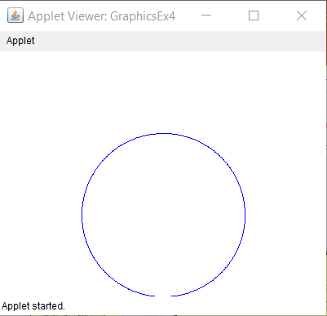
GraphicsEx4 Output

Slide 16
public class GraphicsEx5 extends java.applet.Applet{
public void paint(Graphics g){
int radius = 100; int centerX = 200; int centerY = 200;
double twoPI = 2 * Math.PI;
g.setColor(Color.blue);
int x1 = (int) Math.round(Math.cos(twoPI * 1/6) * radius) + centerX;
int y1 = (int) Math.round(Math.sin(twoPI * 1/6) * radius) + centerY;
int x2 = (int) Math.round(Math.cos(twoPI * 2/6) * radius) + centerX;
int y2 = (int) Math.round(Math.sin(twoPI * 2/6) * radius) + centerY;
int x3 = (int) Math.round(Math.cos(twoPI * 3/6) * radius) + centerX;
int y3 = (int) Math.round(Math.sin(twoPI * 3/6) * radius) + centerY;
int x4 = (int) Math.round(Math.cos(twoPI * 4/6) * radius) + centerX;
int y4 = (int) Math.round(Math.sin(twoPI * 4/6) * radius) + centerY;
int x5 = (int) Math.round(Math.cos(twoPI * 5/6) * radius) + centerX;
int y5 = (int) Math.round(Math.sin(twoPI * 5/6) * radius) + centerY;
int x6 = (int) Math.round(Math.cos(twoPI) * radius) + centerX;
int y6 = (int) Math.round(Math.sin(twoPI) * radius) + centerY;
Polygon hex = new Polygon();
hex.addPoint(x1,y1); hex.addPoint(x2,y2); hex.addPoint(x3,y3);
hex.addPoint(x4,y4); hex.addPoint(x5,y5); hex.addPoint(x6,y6);
g.fillPolygon(hex);
}
}

Slide 17
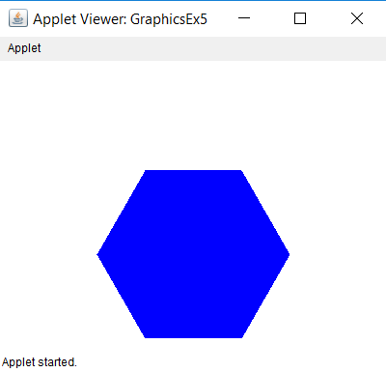
GraphicsEx5 Output

Slide 18
import java.awt.*;
public class GraphicsEx6 extends java.applet.Applet
{
public void paint(Graphics g)
{
g.setColor(Color.red);
int xCoord[] = {400,550,500,300,250};
int yCoord[] = {70,200,350,350,200};
g.fillPolygon(xCoord,yCoord,5);
}
}

Slide 19
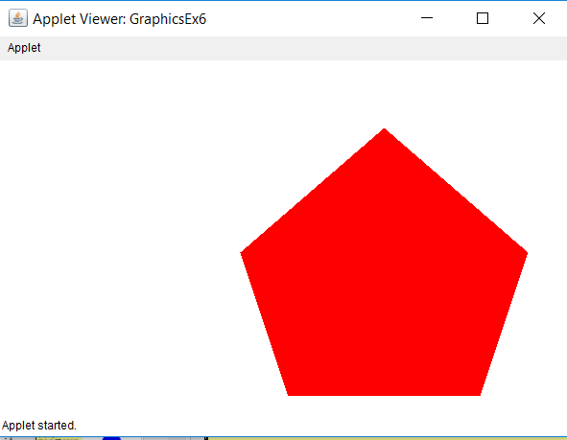
GraphicsEx6 Output

Slide 20
import java.awt.*;
public class GraphicsEx7 extends java.applet.Applet
{
public void paint(Graphics g)
{
g.setColor(Color.blue);
int xCoord[] = {400,550,500,300,250};
int yCoord[] = {70,200,350,350,200};
g.drawPolyline(xCoord,yCoord,5);
}
}

Slide 21
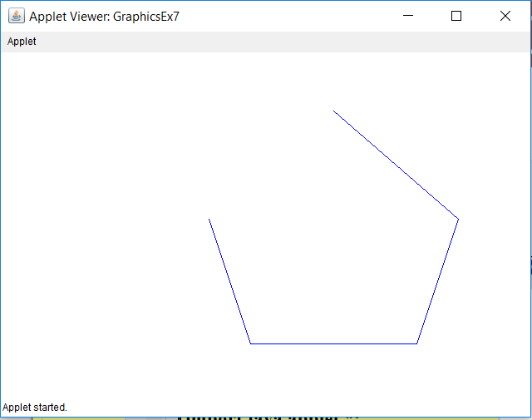
GraphicsEx7 Output

Slide 22
public class GraphicsEx8 extends java.applet.Applet{
public void paint(Graphics g){
int centerX = 400;
int centerY = 300;
int radius = 200;
double twoPI = 2 * Math.PI;
int xCoord[] = new int[6];
int yCoord[] = new int[6];
g.setColor(Color.blue);
for (int k = 0; k < 6; k++){
xCoord[k] = (int) Math.round(Math.cos(twoPI * k/6) * radius) + centerX;
yCoord[k] = (int) Math.round(Math.sin(twoPI * k/6) * radius) + centerY;
}
g.fillPolygon(xCoord,yCoord,6);
}
}

Slide 23
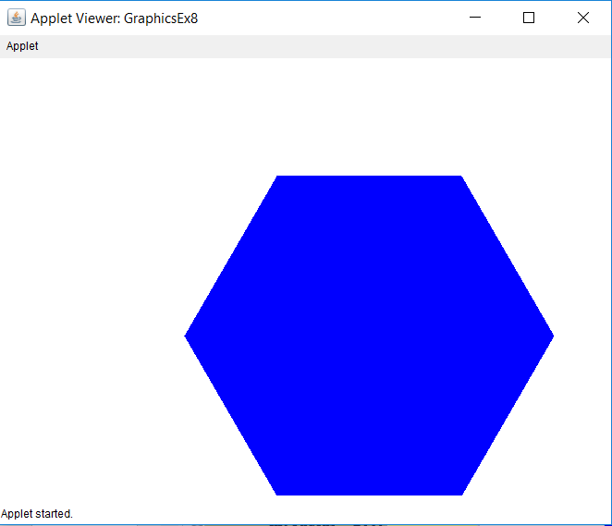
GraphicsEx8 Output

Slide 24
public class GraphicsEx9 extends java.applet.Applet{
public void paint(Graphics g) {
int sides = 5;
for (int y = 100; y <= 500; y+=120) {
for (int x = 100; x <= 800; x+=120)
regPolygon(g,50,x,y,sides);
sides++;
}
}
public void regPolygon(Graphics g, int radius, int centerX, int centerY,int sides) {
double twoPI = 2 * Math.PI;
int xCoord[] = new int[sides];
int yCoord[] = new int[sides];
g.setColor(Color.blue);
for (int k = 0; k < sides; k++) {
xCoord[k] = (int) Math.round(Math.cos(twoPI * k/sides) * radius) + centerX;
yCoord[k] = (int) Math.round(Math.sin(twoPI * k/sides) * radius) + centerY;
}
g.fillPolygon(xCoord,yCoord,sides);
}
}

Slide 25
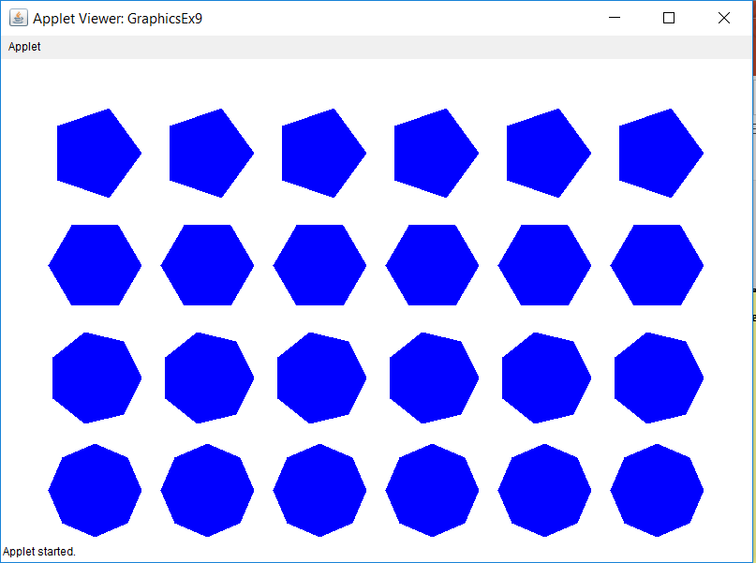
GraphicsEx9 Output

Slide 26
Mouse Routines with Graphics

Slide 27
public class GraphicsEx10 extends Applet{
int numClicks;
public void init() { numClicks = 0; }
public void paint(Graphics g) {
g.drawString("Mouse is clicked " + numClicks + “
times.",20,20);
}
public boolean mouseDown(Event e, int x, int y) {
numClicks++;
repaint();
return true;
}
}

Slide 28
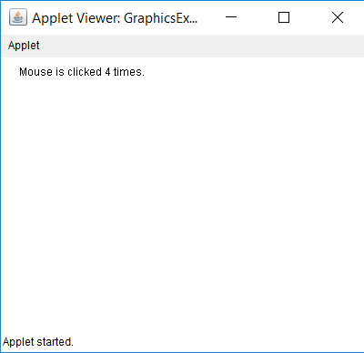
GraphicsEx10 Output

Slide 29
public class GraphicsEx11 extends Applet{
int xCoord, yCoord;
public void paint(Graphics g){
g.drawString("Mouse clicked at (" + xCoord + "," + yCoord
+ ")",20,20);
}
public boolean mouseDown(Event e, int x, int y){
xCoord = x;
yCoord = y;
repaint();
return true;
}
}

Slide 30
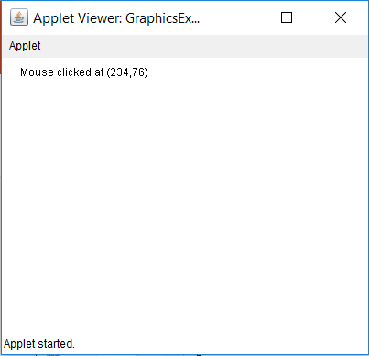
GraphicsEx11 Output

Slide 31
public class GraphicsEx12 extends Applet{
int xCoord, yCoord;
public void paint(Graphics g){
g.drawString("Mouse clicked at (" + xCoord + "," + yCoord
+ ")",20,20);
}
public boolean mouseDown(Event e, int x, int y){
xCoord = x;
yCoord = y;
repaint();
return true;
}
}

Slide 32
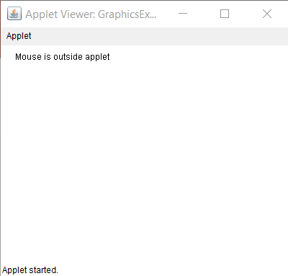
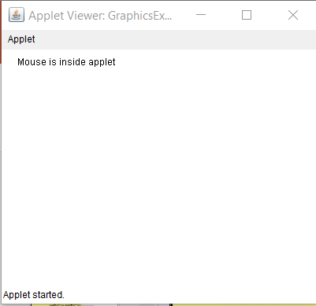
GraphicsEx12 Output

Slide 33
public class GraphicsEx13 extends Applet{
boolean singleClick,doubleClick;
public void paint(Graphics g){
if (singleClick)
g.drawString("Mouse was clicked once",20,20);
if (doubleClick)
g.drawString("Mouse was clicked twice",20,20);
}
public boolean mouseDown(Event e, int x, int y){
switch (e.clickCount){
case 1:
singleClick = true; doubleClick = false;
break;
case 2:
doubleClick = true; singleClick = false;
}
repaint();
return true;
}
}

Slide 34
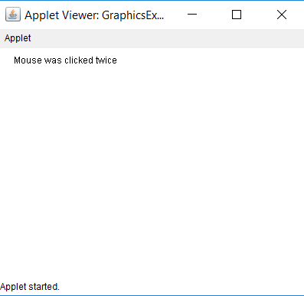
GraphicsEx13 Output

Slide 35
import java.awt.*;
import java.applet.Applet;
public class GraphicsEx14 extends Applet{
int xCoord, yCoord;
public void paint(Graphics g){
g.drawString("Mouse is located at (" + xCoord + "," + yCoord + ")",20,20);
}
public boolean mouseMove(Event e, int x, int y){
xCoord = x;
yCoord = y;
repaint();
return true;
}
}

Slide 36
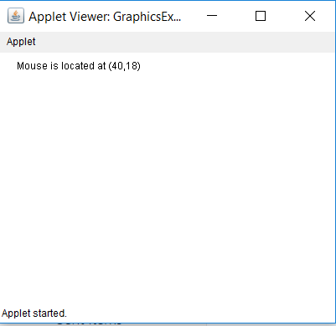
GraphicsEx14 Output

Slide 37
import java.awt.*;
import java.applet.Applet;
public class GraphicsEx15 extends Applet{
int xCoord, yCoord;
public void paint(Graphics g){
g.drawString("Mouse is located at (" + xCoord + "," + yCoord + ")",20,20);
}
public boolean mouseDrag(Event e, int x, int y){
xCoord = x;
yCoord = y;
repaint();
return true;
}
}

Slide 38
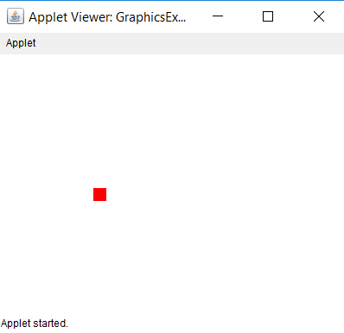
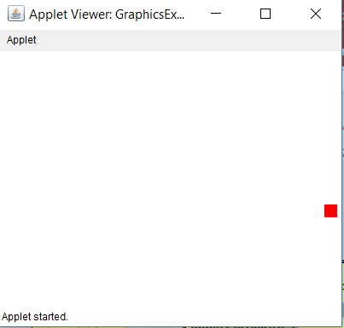
GraphicsEx15 Output

Slide 39
public class GraphicsEx16 extends Applet{
int xCoord[];
int yCoord[];
int numSquare;
boolean firstPaint;
public void init() {
xCoord = new int[100];
yCoord = new int[100];
numSquare = 0;
firstPaint = true;
}
public void paint(Graphics g){
g.setColor(Color.red);
for (int k = 0; k < numSquare; k++)
g.fillRect(xCoord[k],yCoord[k],15,15);
}
public boolean mouseDown(Event e, int x, int y) {
xCoord[numSquare] = x;
yCoord[numSquare] = y;
numSquare++;
repaint();
return true;
}
}

Slide 40
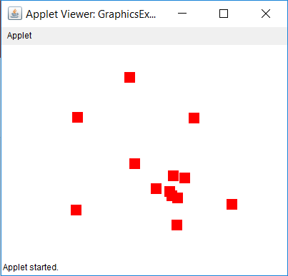
GraphicsEx16 Output

Slide 41
public class GraphicsEx17 extends Applet{
Rectangle red, green, blue;
int numColor;
public void init(){
red = new Rectangle(50,50,100,100);
green = new Rectangle(50,200,100,100);
blue = new Rectangle(50,350,100,100);
numColor = 0;
}
public boolean mouseDown(Event e, int x, int y)
{
if(red.inside(x,y))
numColor = 1;
else if(green.inside(x,y))
numColor = 2;
else if(blue.inside(x,y))
numColor = 3;
else
numColor = 4;
repaint();
return true;
}
public void paint(Graphics g){
g.setColor(Color.red);
g.fillRect(50,50,100,100);
g.setColor(Color.green);
g.fillRect(50,200,100,100);
g.setColor(Color.blue);
g.fillRect(50,350,100,100);
switch (numColor){
case 1:
g.setColor(Color.red);
g.drawString("Mouse clicked inside red", 200,75);
break;
case 2:
g.setColor(Color.green);
g.drawString("Mouse clicked inside green", 200,225);
break;
case 3:
g.setColor(Color.blue);
g.drawString("Mouse clicked inside blue", 200,375);
break;
case 4:
g.setColor(Color.black);
g.drawString(
"Mouse is clicked outside the colored squares",
50,20);
break;
} }}

Slide 42
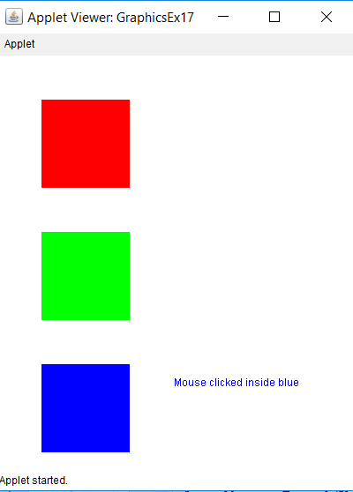
GraphicsEx17 Output

Slide 43
public class GraphicsEx18 extends Applet{
int startX,startY,endX,endY;
public void paint(Graphics g){
g.drawLine(startX,startY,endX,endY);
}
public boolean mouseDown(Event e, int x, int y){
startX = x;
startY = y;
return true;
}
public boolean mouseUp(Event e, int x, int y){
endX = x;
endY = y;
repaint();
return true;
}
}

Slide 44
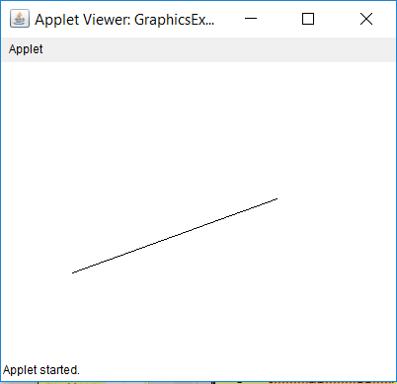
GraphicsEx18 Output

Slide 45
public class GraphicsEx19 extends Applet {
int startX,startY,endX,endY;
public void paint(Graphics g) {
g.drawLine(startX,startY,endX,endY);
}
public boolean mouseDown(Event e, int x, int y) {
startX = x;
startY = y;
return true;
}
public boolean mouseDrag(Event e, int x, int y){
endX = x;
endY = y;
repaint();
return true;
}
}

Slide 46
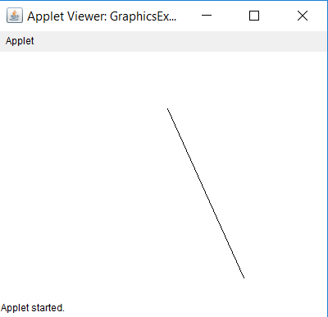
GraphicsEx19

Slide 47
public class GraphicsEx20 extends Applet {
int[] startX,startY,endX,endY;
int currentStartX,currentStartY;
int currentEndX,currentEndY;
boolean currentLineDone;
int lineCount;
public void init(){
startX = new int[100];
startY = new int[100];
endX = new int[100];
endY = new int[100];
lineCount = 0;
currentLineDone = false;
}
public void paint(Graphics g) {
for (int k = 0; k < lineCount; k++)
g.drawLine(startX[k],startY[k],endX[k],endY[k]);
if (!currentLineDone)
g.drawLine(currentStartX,currentStartY,currentEndX,currentEndY);
currentLineDone = false;
}
public boolean mouseDown(Event e, int x, int y) {
currentStartX = x; currentStartY = y;
return true;
}
public boolean mouseDrag(Event e, int x, int y) {
currentEndX = x; currentEndY = y;
repaint();
return true;
}
public boolean mouseUp(Event e, int x, int y) {
addLine(x,y);
currentLineDone = true;
return true;
}
public void addLine(int x, int y) {
startX[lineCount] = currentStartX;
startY[lineCount] = currentStartY;
endX[lineCount] = x;
endY[lineCount] = y;
lineCount++;
repaint();
} }

Slide 48
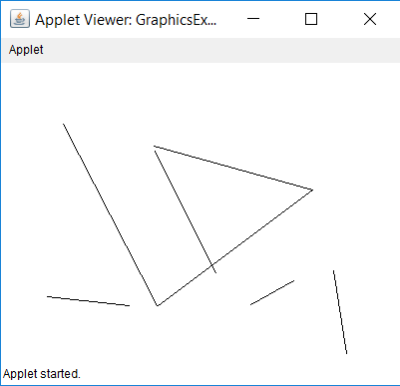
GraphicsEx20

